Slide 1

Social Media Management (IG)

Slide 2
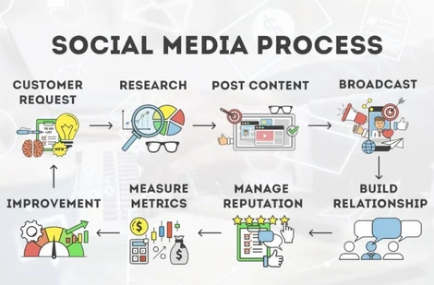
Workflow and Timeline
Establishing a clear workflow and timeline is crucial for the successful execution of the social media strategy on Instagram.
Workflow involves content creation, review, scheduling, and publishing.
Timeline ensures tasks are completed on time for efficient strategy implementation as per approved content calendar.

Slide 3
Content Calendar (30 Days)
Roadmap for the next 30 days on Instagram.
Types of content, themes, and posting schedule outlined and shared for review
Short Engaging Videos (Reels, Stories): (3-5 times a week)
Showcase the Process of making. (up close shots)
Before & After.
Quick tips.
Employee spotlight or "a day in the life".
Feature customer testimonials or reviews (with permission).
High-Quality Photos: (2-3 times a week)
Professionally shot images of Product.
Mockups showcasing.
Inspirational quotes.
Behind-the-scenes glimpses
Informative Carousel Posts: (Once a week)

Slide 4
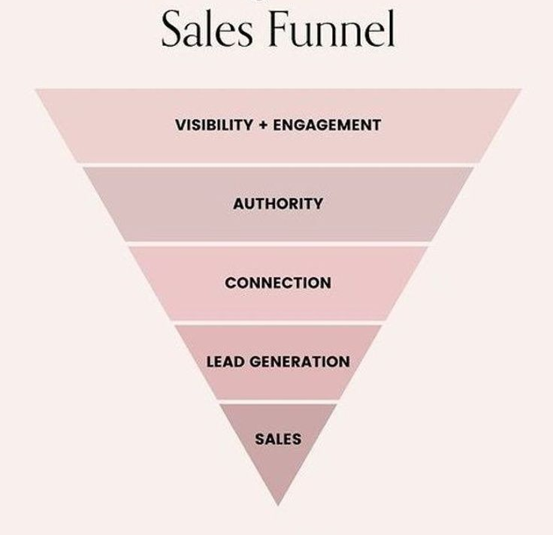
Instagram Funnel
Instagram strategy will focus on Lead Gen,
By increasing the Visibility by connecting with similar accounts.
By posting authoritative contents
By Sharing testimonials

Slide 5
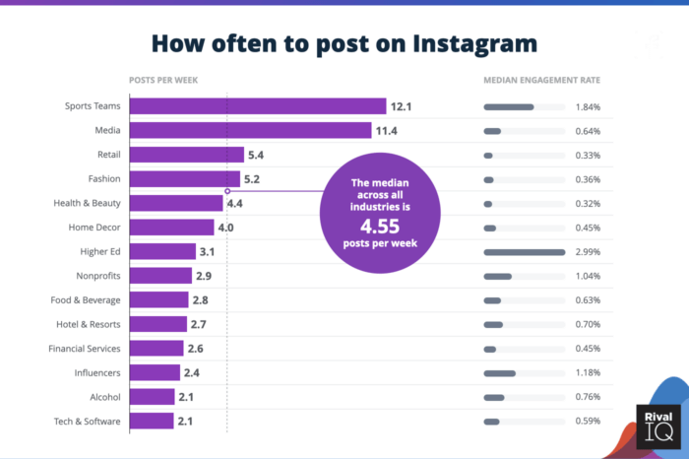
Posting Frequency and Optimal Timing
To maximize the reach and engagement of Instagram account, the following posting frequency and optimal timing guidelines will be implemented:
Posting Frequency
Publish 3-4 high-quality posts per week to maintain a consistent presence and keep followers engaged.
Optimal Timing
Post during peak user activity times, such as early afternoon (12 pm - 3 pm) and evenings (7 pm - 10 pm), on weekdays and weekends.

Slide 6




Engagement and Community Building
The following strategies will be implemented to drive engagement and build a loyal following:
Respond to Comments
Engage with Followers
Utilize Relevant Hashtags
Collaborate with Influencers
Promptly respond to all comments, questions, and direct messages to show followers that Bass Printing values their feedback and is actively engaged with the community.
Regularly like, comment, and share content from the brand's followers to demonstrate their appreciation and foster a sense of community.
Strategically use a mix of branded, industry-specific, and location-based hashtags to increase the visibility of the brand's content and reach new potential followers.
Partner with relevant industry influencers and content creators to tap into their existing audiences and cross-promote the Bass Printing brand.

Slide 7



Paid Advertising and Boosting Strategy
To further amplify the reach and impact of the Instagram content, a strategic paid advertising and boosting strategy will be implemented. This will involve a combination of targeted ad campaigns and boosting of high-performing organic posts.
Audience Targeting
Ad Formats
Boosting Strategy
Leverage detailed audience insights to identify and reach the brand's ideal customers, including local businesses, similar professionals, and small-to-medium-sized enterprises.
Utilize a mix of Instagram ad formats, such as carousel ads, video ads, and stories ads, to showcase the brand's products and services in a visually engaging way.
Analyze the performance of organic posts and selectively boost the highest-performing content to extend its reach and drive further engagement and conversions.

Slide 8
Reporting and Performance Tracking
Regular reporting and performance tracking will be essential for evaluating the success of the social media strategy and making data-driven decisions to optimize the approach. The following metrics will be closely monitored and analyzed:
Follower Growth
Engagement Rate
Track the growth of the Instagram account's follower count to measure the effectiveness of the content and engagement strategies.
Monitor the likes, comments, and shares received on posts to gauge the level of audience engagement and interaction with the brand's content.
Reach and Impressions
Conversion Metrics
Analyze the reach and impressions of the brand's posts to understand the visibility and impact of the content among the target audience.
Track website visits, lead generation, and other conversion-related metrics to measure the impact of the Instagram strategy on the brand's overall business objectives.

Slide 9
Thank You
Vijay B
Business Developer
vijay@vleads.co.in

